Slide 1
Final Project TWEET ANALYSER
Submitted By: Shree Krishna Poudel
Submitted To: Prof. Mrudula Mukadam

Slide 2
Project Overview
Twitter Stream: I have used twitter API to get stream of tweets from twitter
Kafka: Distributed messaging system which is used for streaming analytics and data integration
Spark: It is used for getting the tweets from Kafka and performing some filter and aggregation
HBase: The enriched hashtag frequency is saved in HBase.

Slide 3
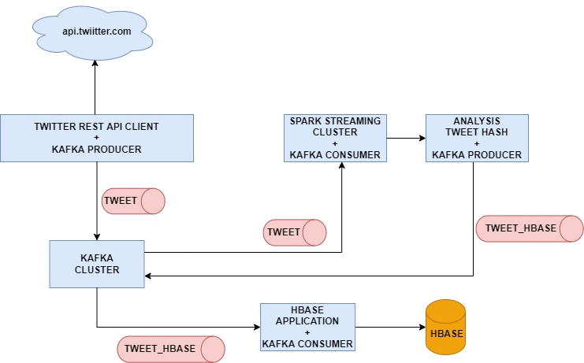
Project Overview

Slide 4
Technology stack used
Kafka – 3.1.0
Spark – 1.6.0
Java - 8
Hadoop – 2.6.0
Hbase – 1.3.1
Twitter Stream
Spring Boot : 2.7

Slide 5

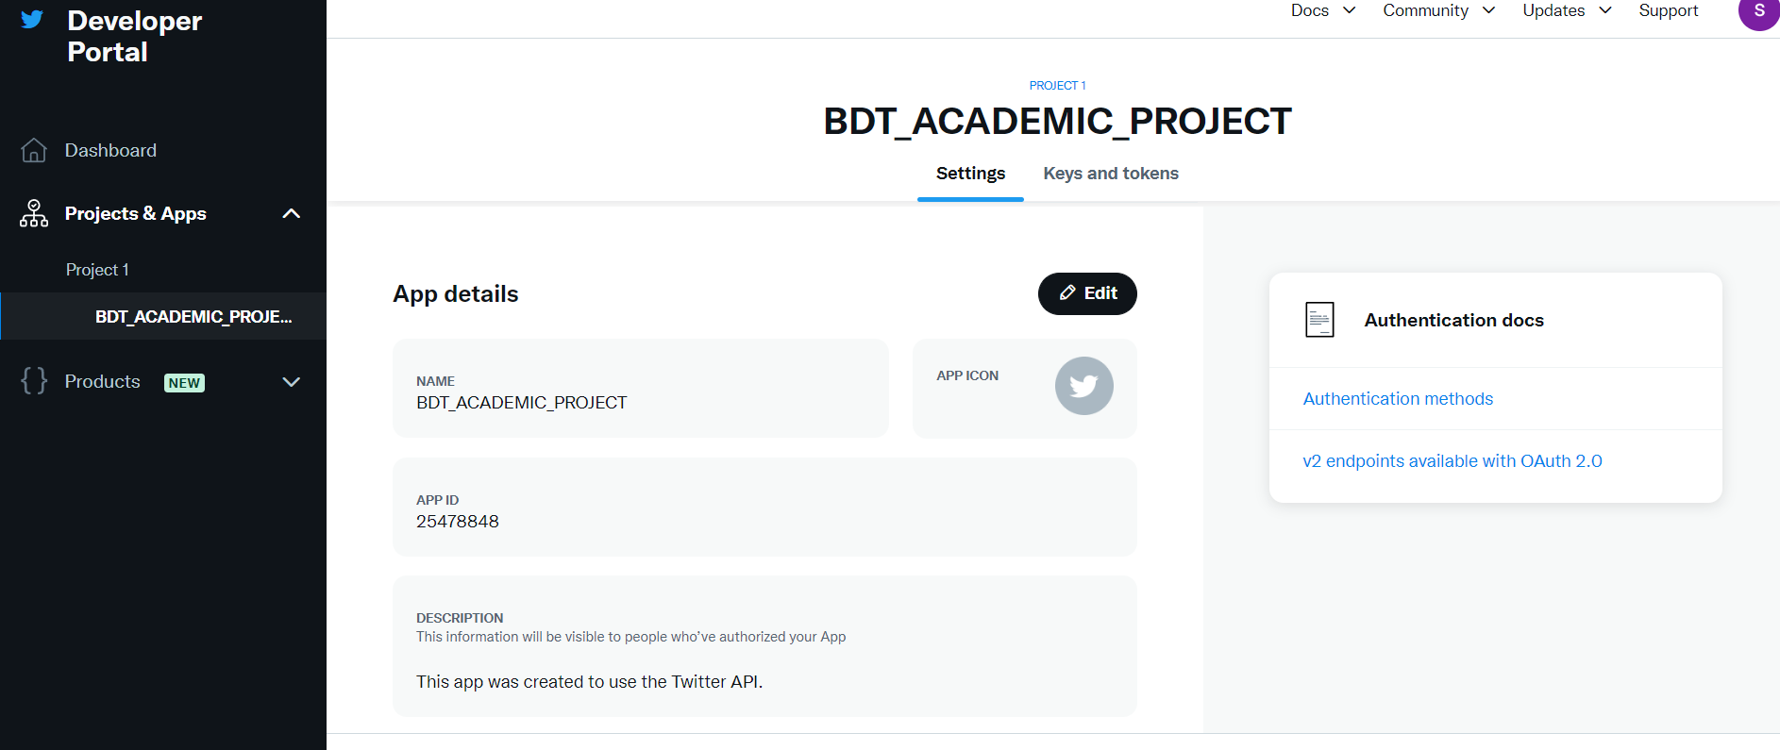
Twitter API
Allows us to stream public Tweets from the platform in real-time
Provides an api https://api.twitter.com/2/tweets/sample/stream for streaming
Need to provide bearer token to access api
I have implement okHttpClient for consuming twitter stream data

Slide 6
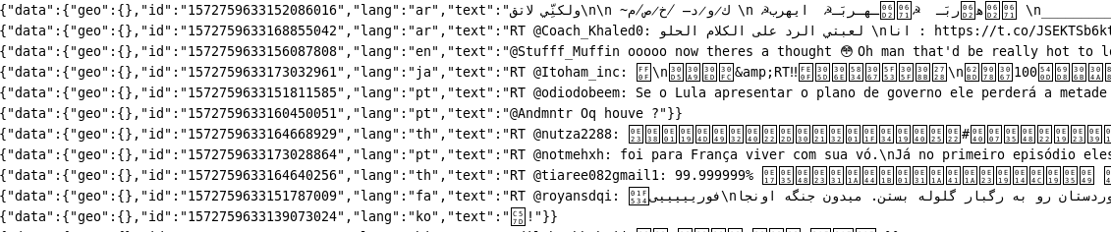
Twitter Stream
Received tweets are send to Kafka on TWEET topic.
Fig 2: Twitter stream console

Slide 7

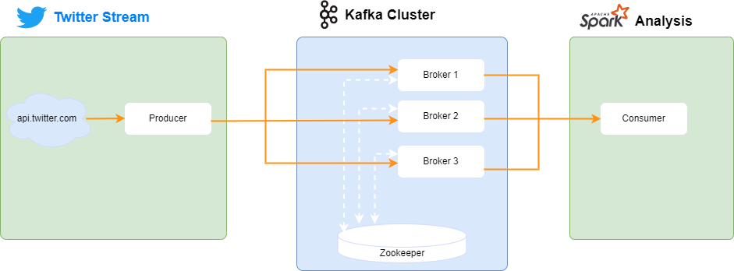
Apache Kafka
Consist three brokers (Kafka cluster) and manage by zookeeper
Consist topics TWEET and TWEET_HBASE
TWEET topic for sending tweets stream to Spark
TWEET_HBASE for sending enriched hashtag frequency data to persist at HBase

Slide 8

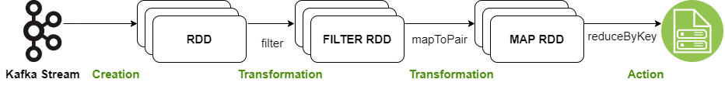
Spark Streaming
Consumer tweets from topic TWEET
Filter English tweet only
Finds hashtag in tweets and calculate frequency with aggregation
Produce enriched hashtag frequency in kafka TWEET_HBASE topic

Slide 9

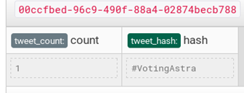
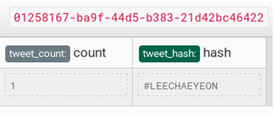
Apache HBASE
The process data from spark (enriched hashtag frequency) is persist in HBase database
Column families tweet_count and tweet_hash which are the key value pairs

Slide 10
Demo steps
Step 1:
Created a twitter developer account (https://developer.twitter.com)
Generated Bearer Token
Step 2:
Download Kafka from https://archive.apache.org/dist/kafka/
Extract at opt i.e. /opt/kafka_2.11-1.1.0
Run Zookeeper : bin/zookeeper-server-start.sh config/zookeeper.properties
Since we will have 3 servers, it’s better to maintain 3 configuration files for each server. Copy the config/server.properties file and make 3 files for each server instance
cp config/server.properties config/server.1.properties cp config/server.properties config/server.2.properties cp config/server.properties config/server.3.properties

Slide 11
Demo steps (Continue..)
Change the above 3 properties for each copy of the file so that they are all unique.
server.1.properties broker.id=1 listeners=PLAINTEXT://:9093 log.dirs=/tmp/kafka-logs1 server.2.properties broker.id=2 listeners=PLAINTEXT://:9094 log.dirs=/tmp/kafka-logs2 server.3.properties broker.id=3 listeners=PLAINTEXT://:9096 log.dirs=/tmp/kafka-logs3

Slide 12
Demo steps (Continue..)
Create the log directories that we configured:
Finally, we can start the broker instances. Run the below three commands on different terminal sessions:
mkdir /tmp/kafka-logs1 mkdir /tmp/kafka-logs2 mkdir /tmp/kafka-logs3
bin/kafka-server-start.sh config/server.1.properties bin/kafka-server-start.sh config/server.2.properties bin/kafka-server-start.sh config/server.3.properties

Slide 13
Demo steps (Continue..)
Creating Topics
bin/kafka-topics.sh --create --topic TWEET --bootstrap-server localhost:9093 --partitions 3 --replication-factor 2 bin/kafka-topics.sh --create --topic TWEET_HBASE --bootstrap-server localhost:9093 --partitions 3 --replication-factor 2

Slide 14
Demo steps (Continue..)
Step 3:
Run the Twitter Kafka Producer Application
It fetches tweets from twitter API and produce to Kafka cluster on topic TWEET
Step 4:
Run the Spark Kafka Application(Spark Streaming) which aggregation/filter tweets and produce Kafka cluster on topic TWEET_HBASE
Step 5:
Run the twitter-hbase which store process data to HBase datastore.

Slide 15


